Slide 1
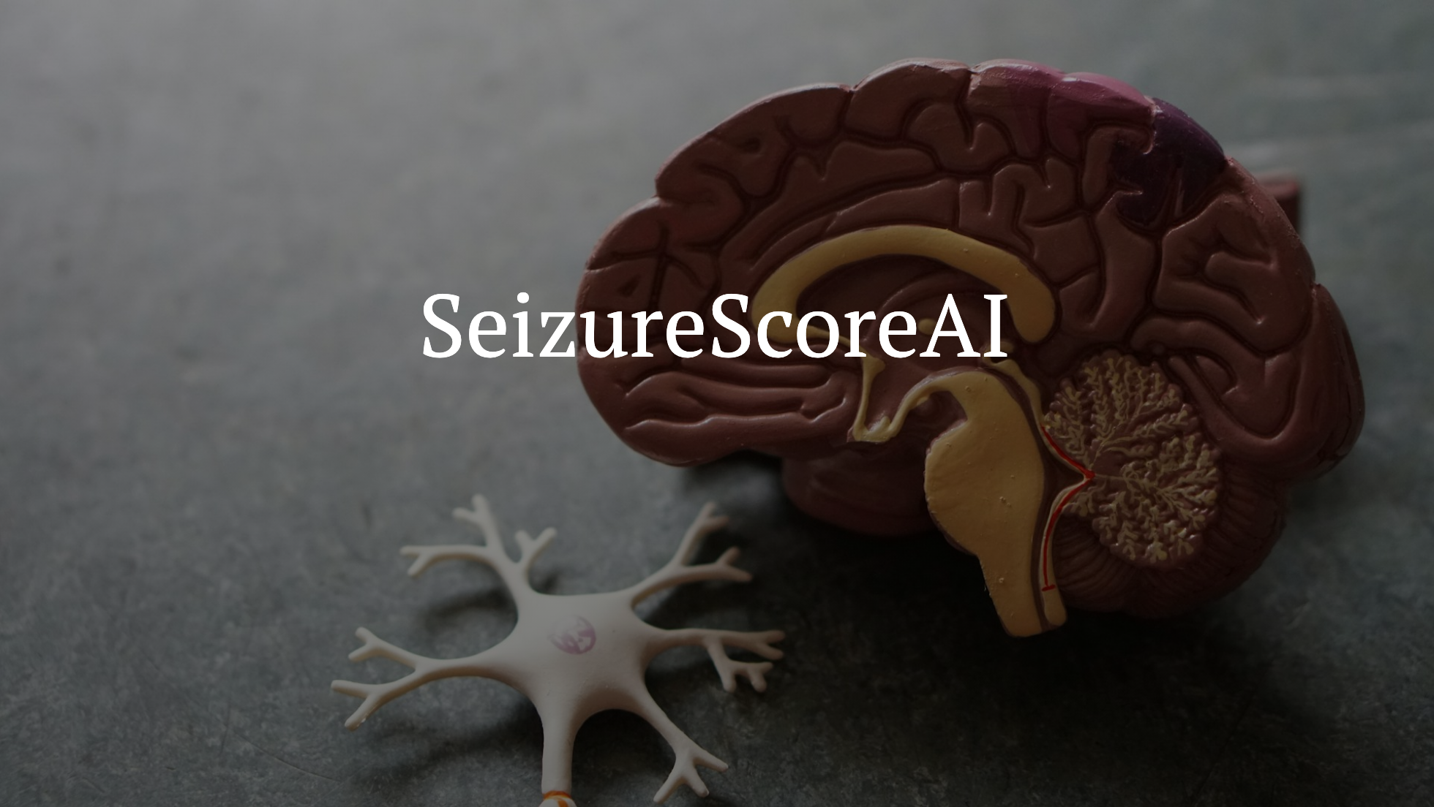

Slide 2
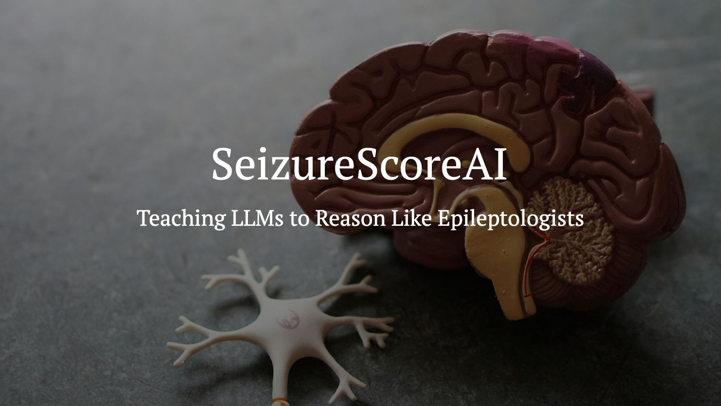

Slide 3
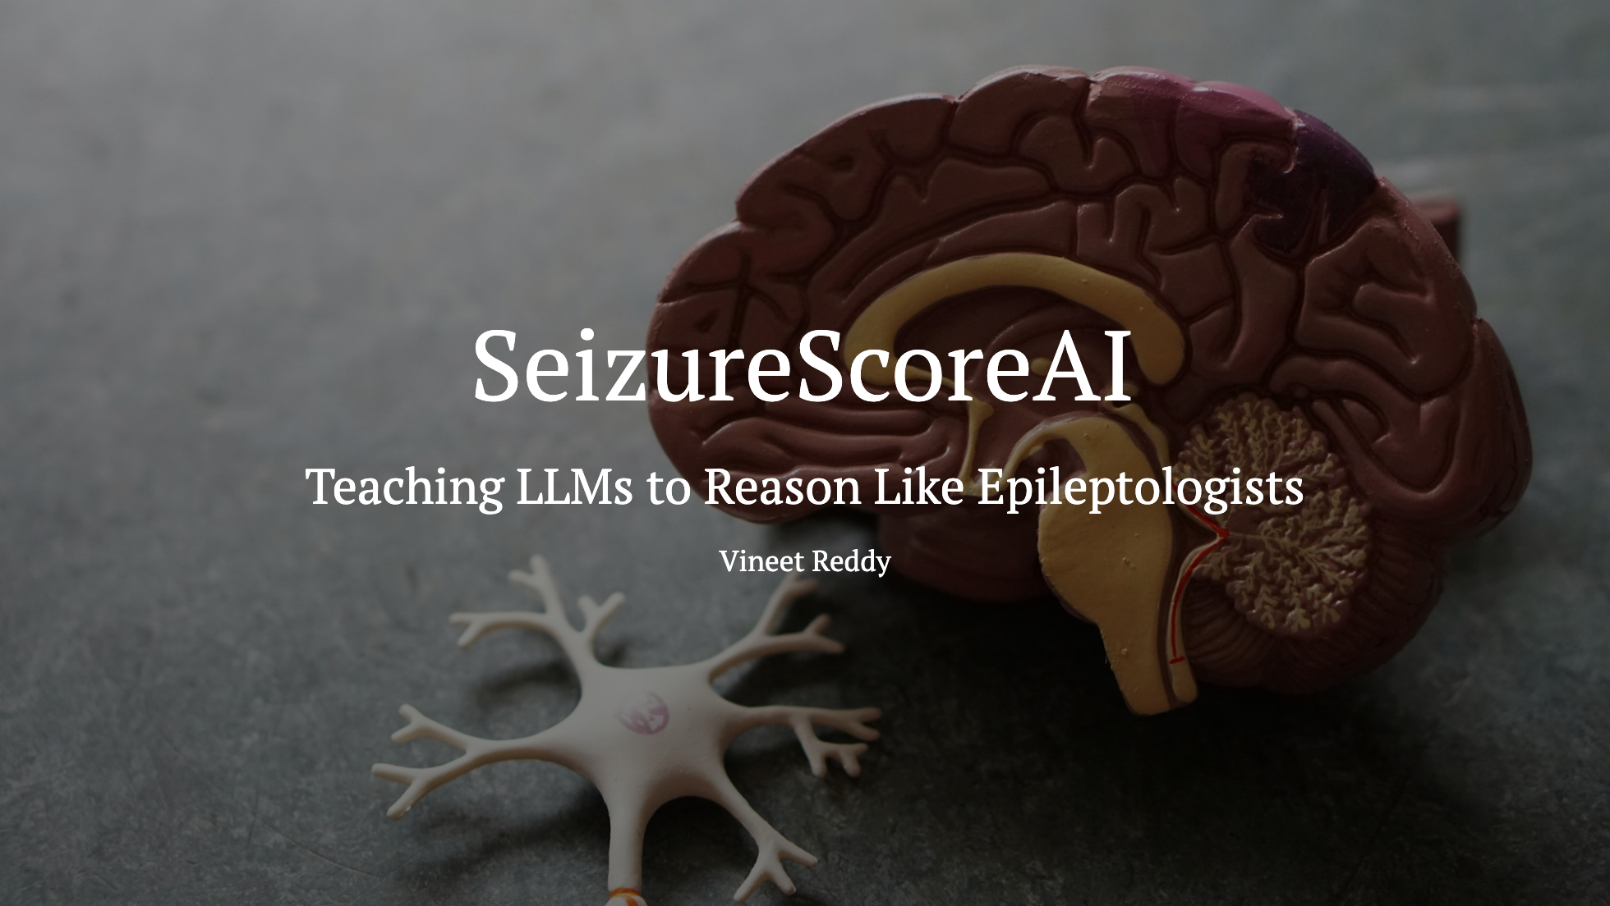

Slide 4
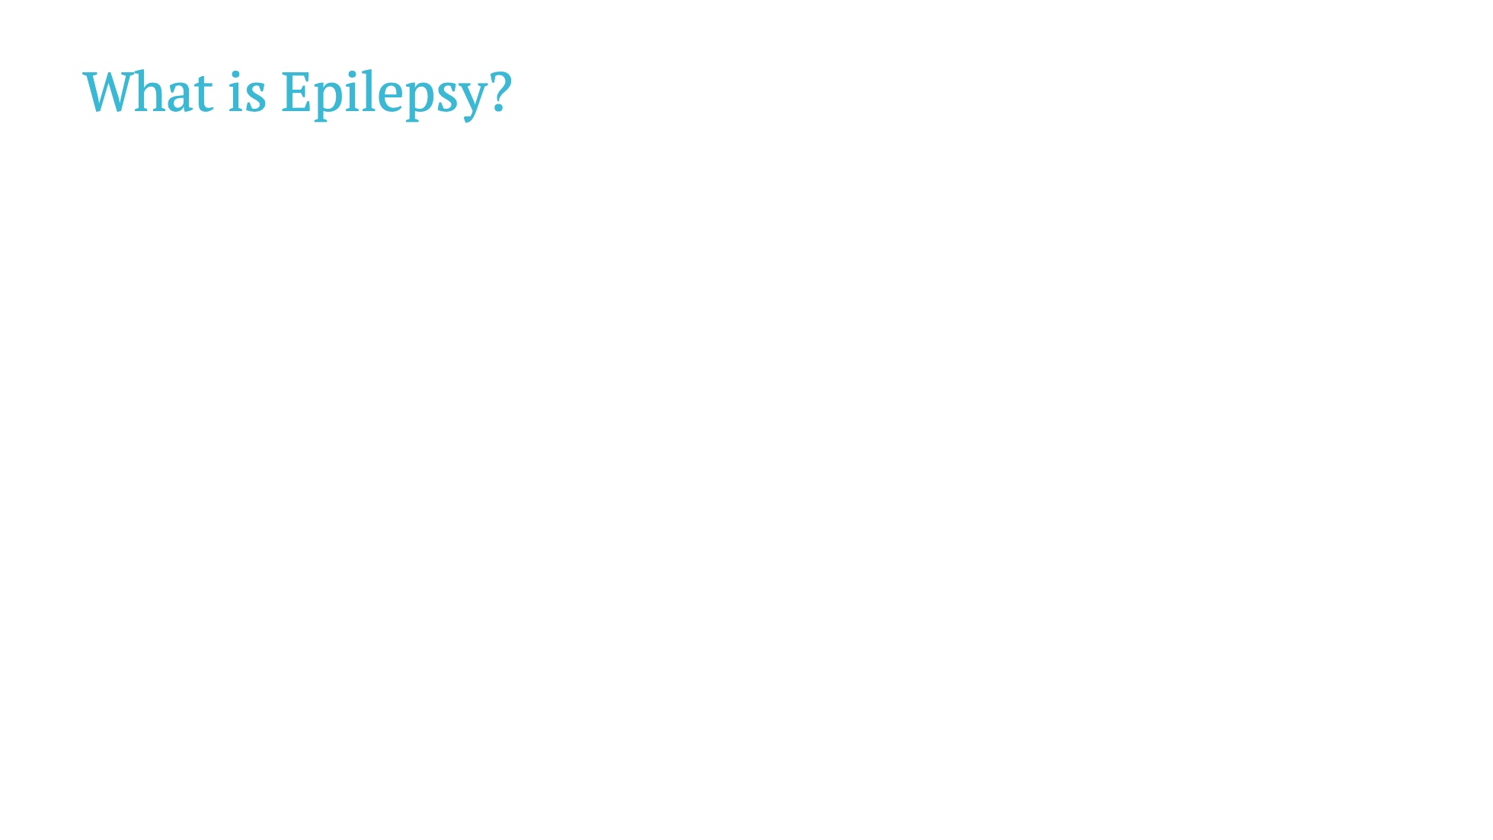
Notes:
Epilepsy is a neurological disorder. After surgery, clinicians need a standardized way to measure outcomes.

Slide 5
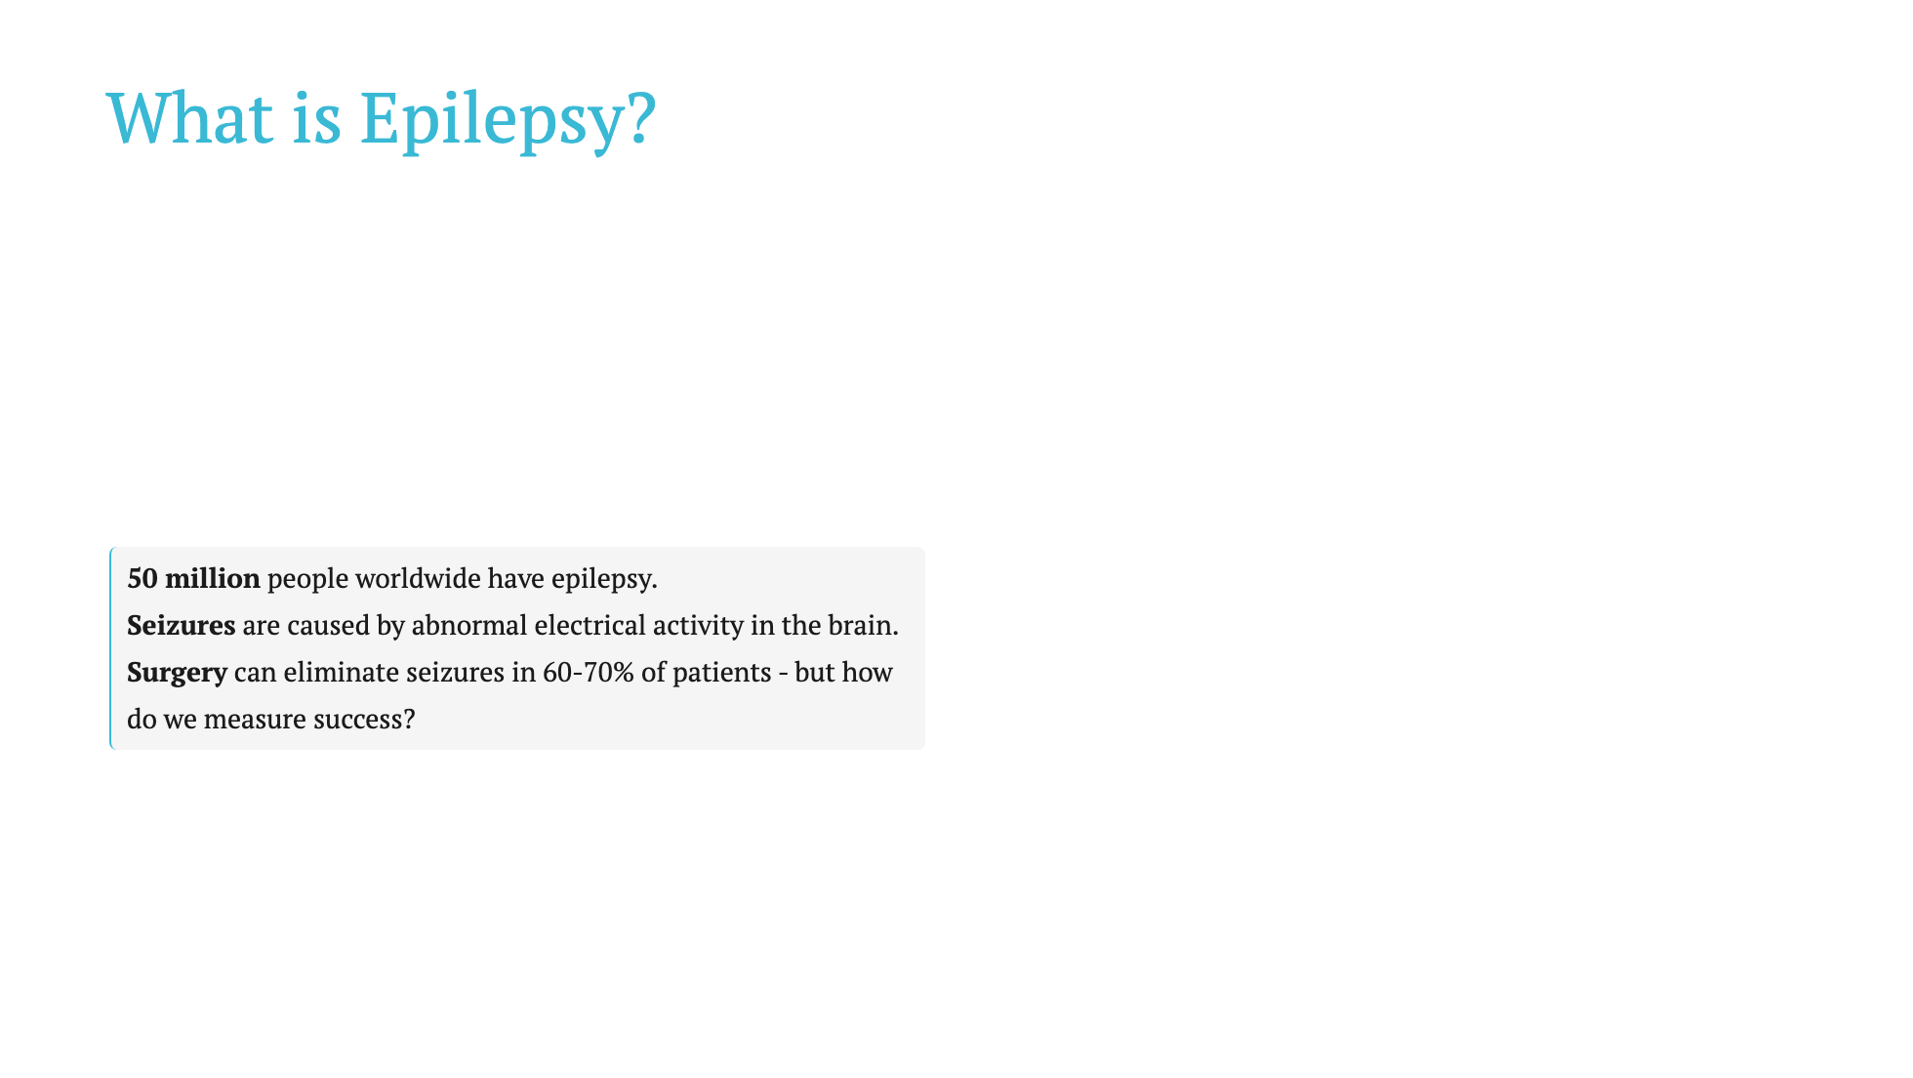
Notes:
Epilepsy is a neurological disorder. After surgery, clinicians need a standardized way to measure outcomes.

Slide 6
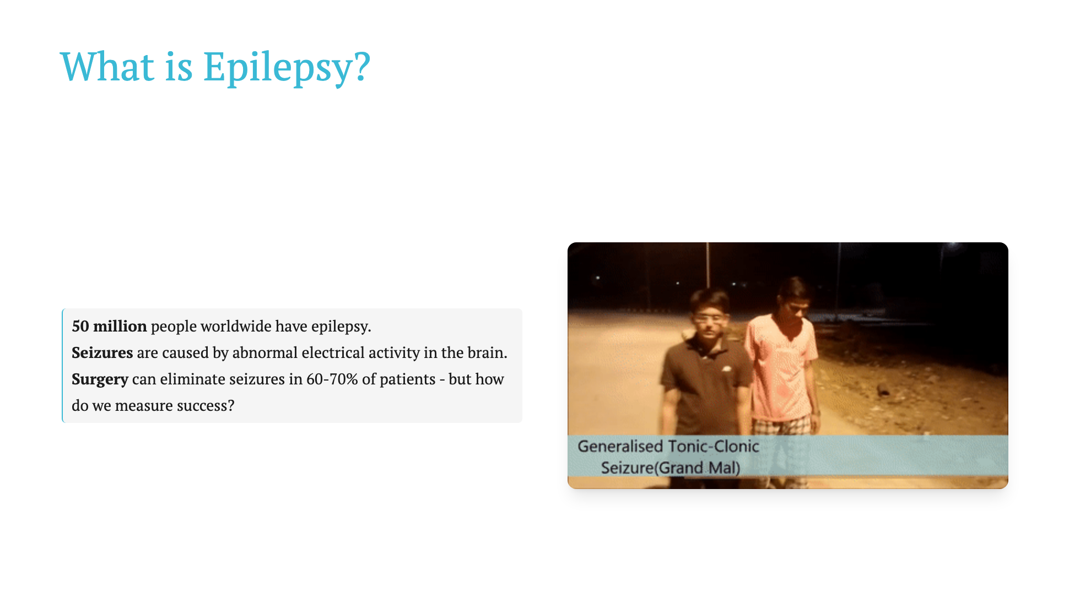
Notes:
Epilepsy is a neurological disorder. After surgery, clinicians need a standardized way to measure outcomes.

Slide 7
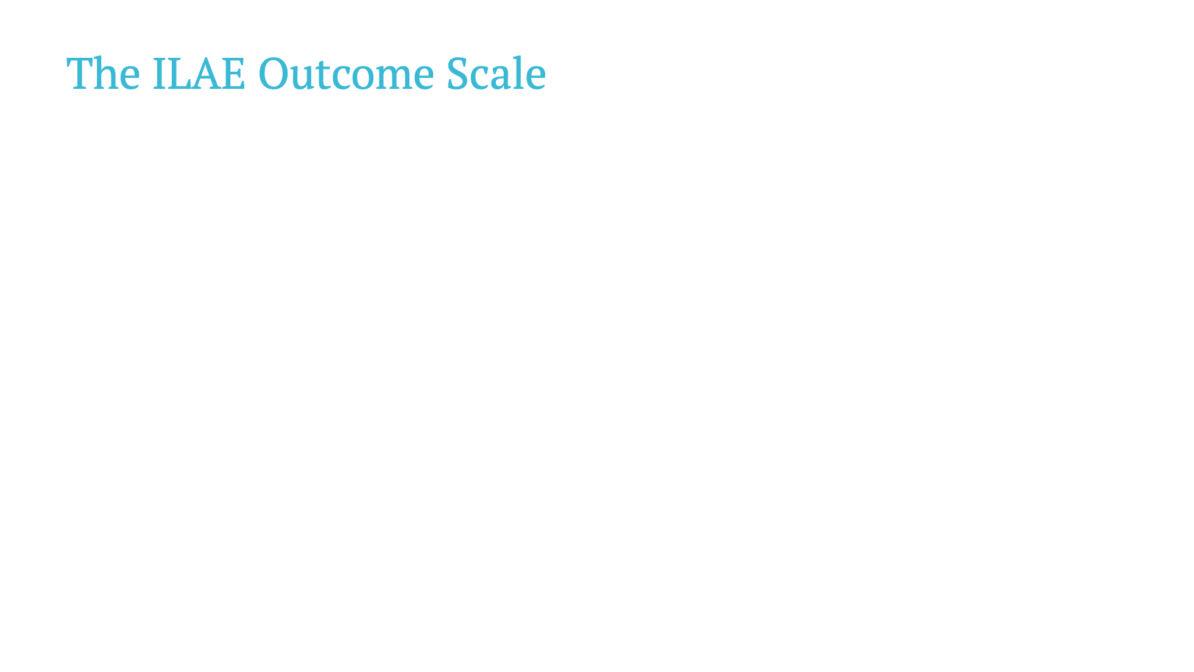
Notes:
ILAE = International League Against Epilepsy. Gold standard for measuring surgical outcomes.

Slide 8
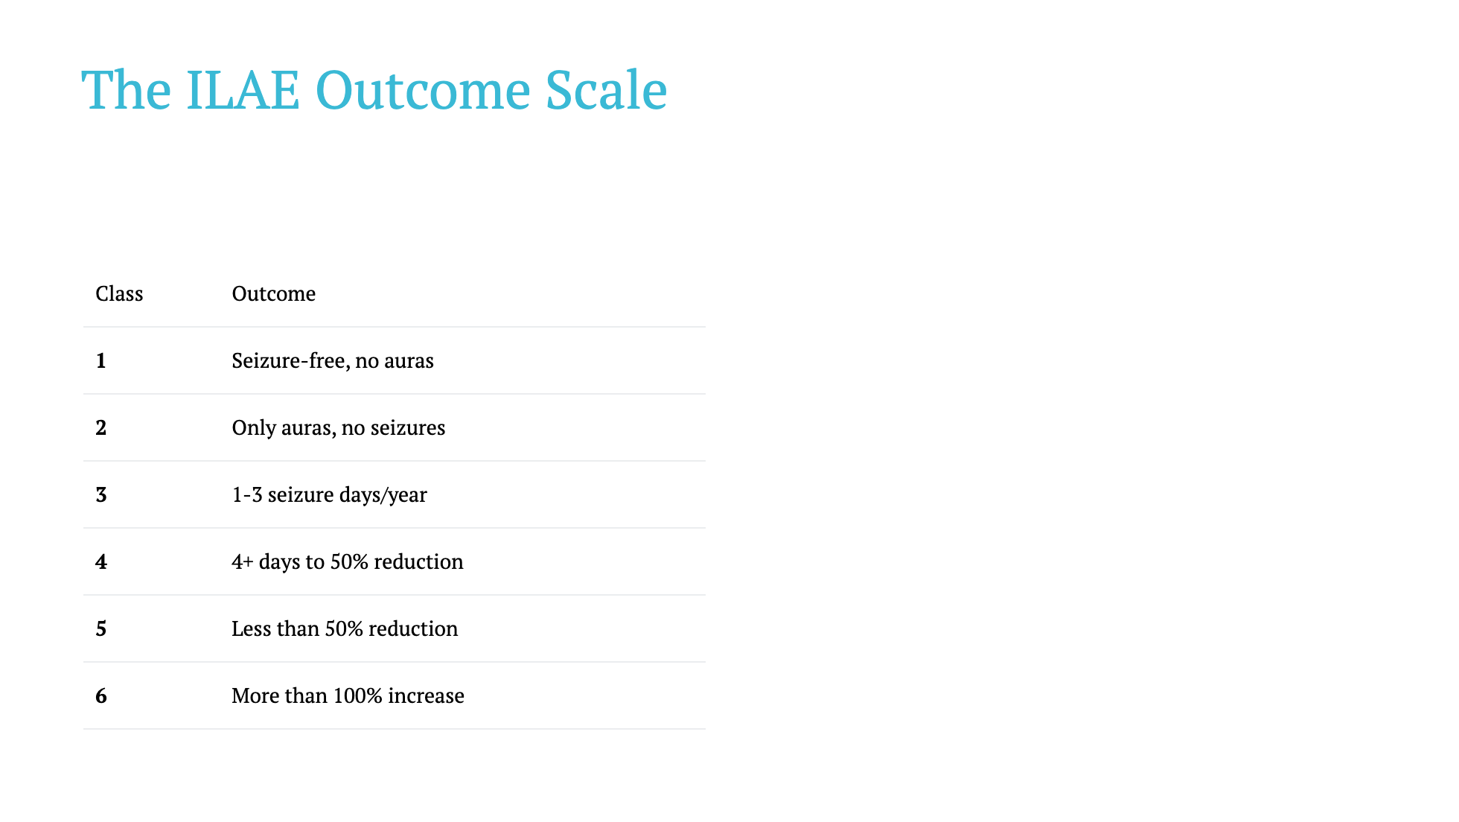
Notes:
ILAE = International League Against Epilepsy. Gold standard for measuring surgical outcomes.

Slide 9
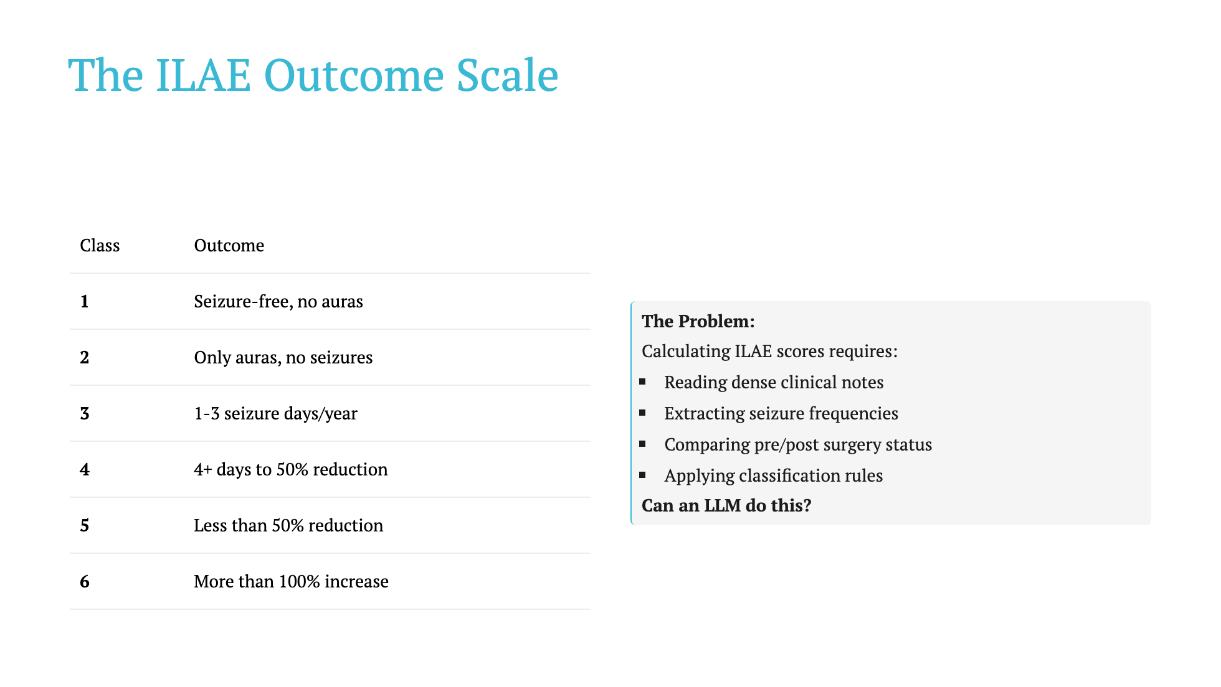
Notes:
ILAE = International League Against Epilepsy. Gold standard for measuring surgical outcomes.

Slide 10
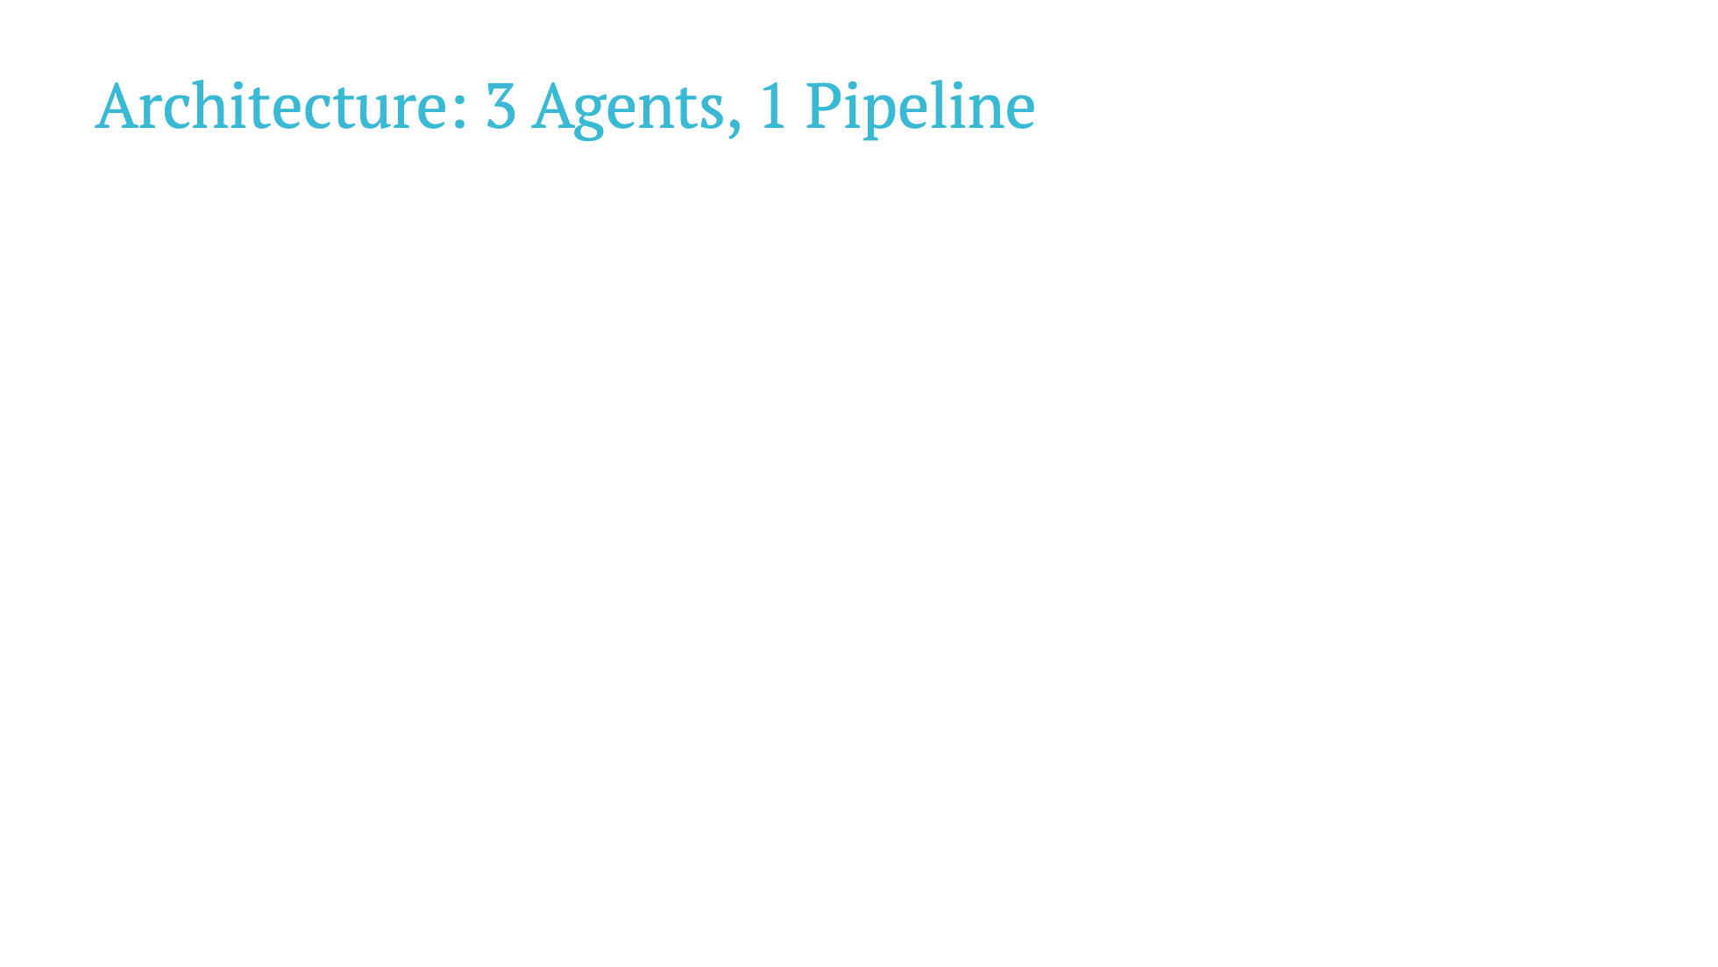
Notes:
Google's Agent Development Kit handles session management and agent orchestration.

Slide 11
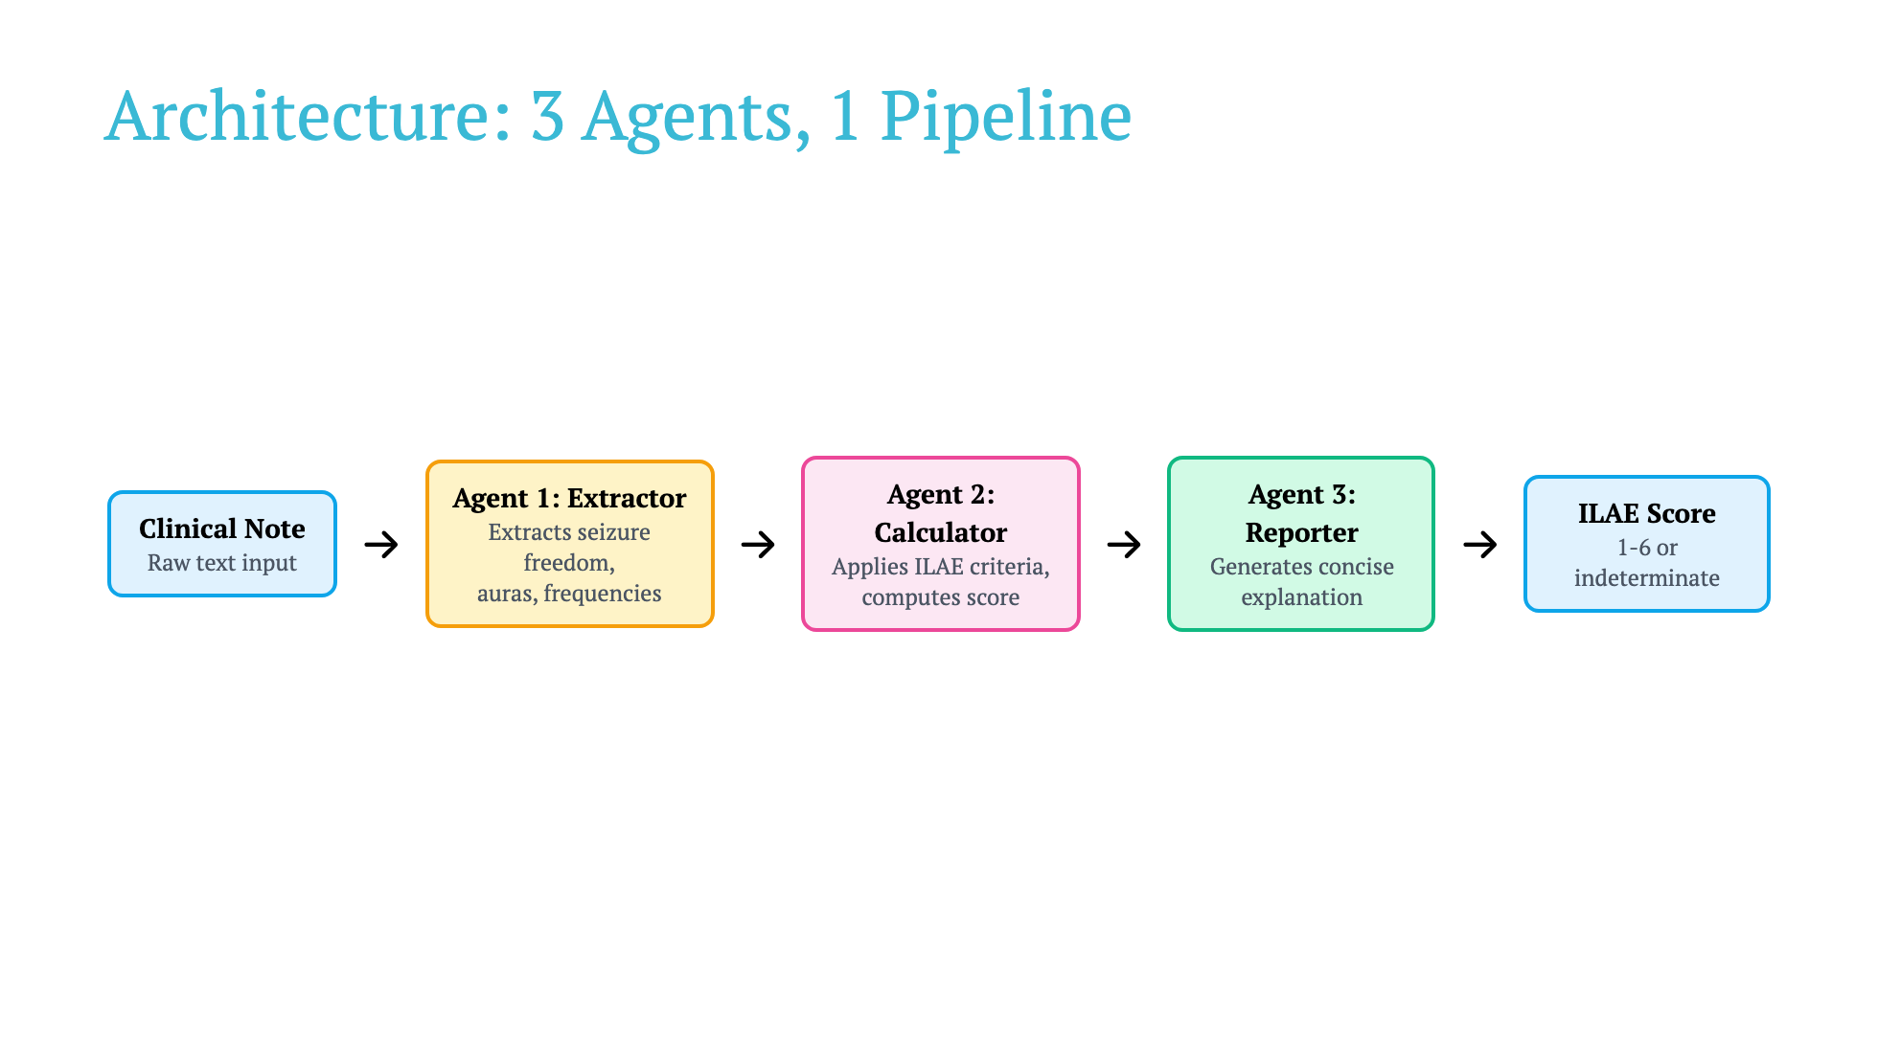
Notes:
Google's Agent Development Kit handles session management and agent orchestration.

Slide 12
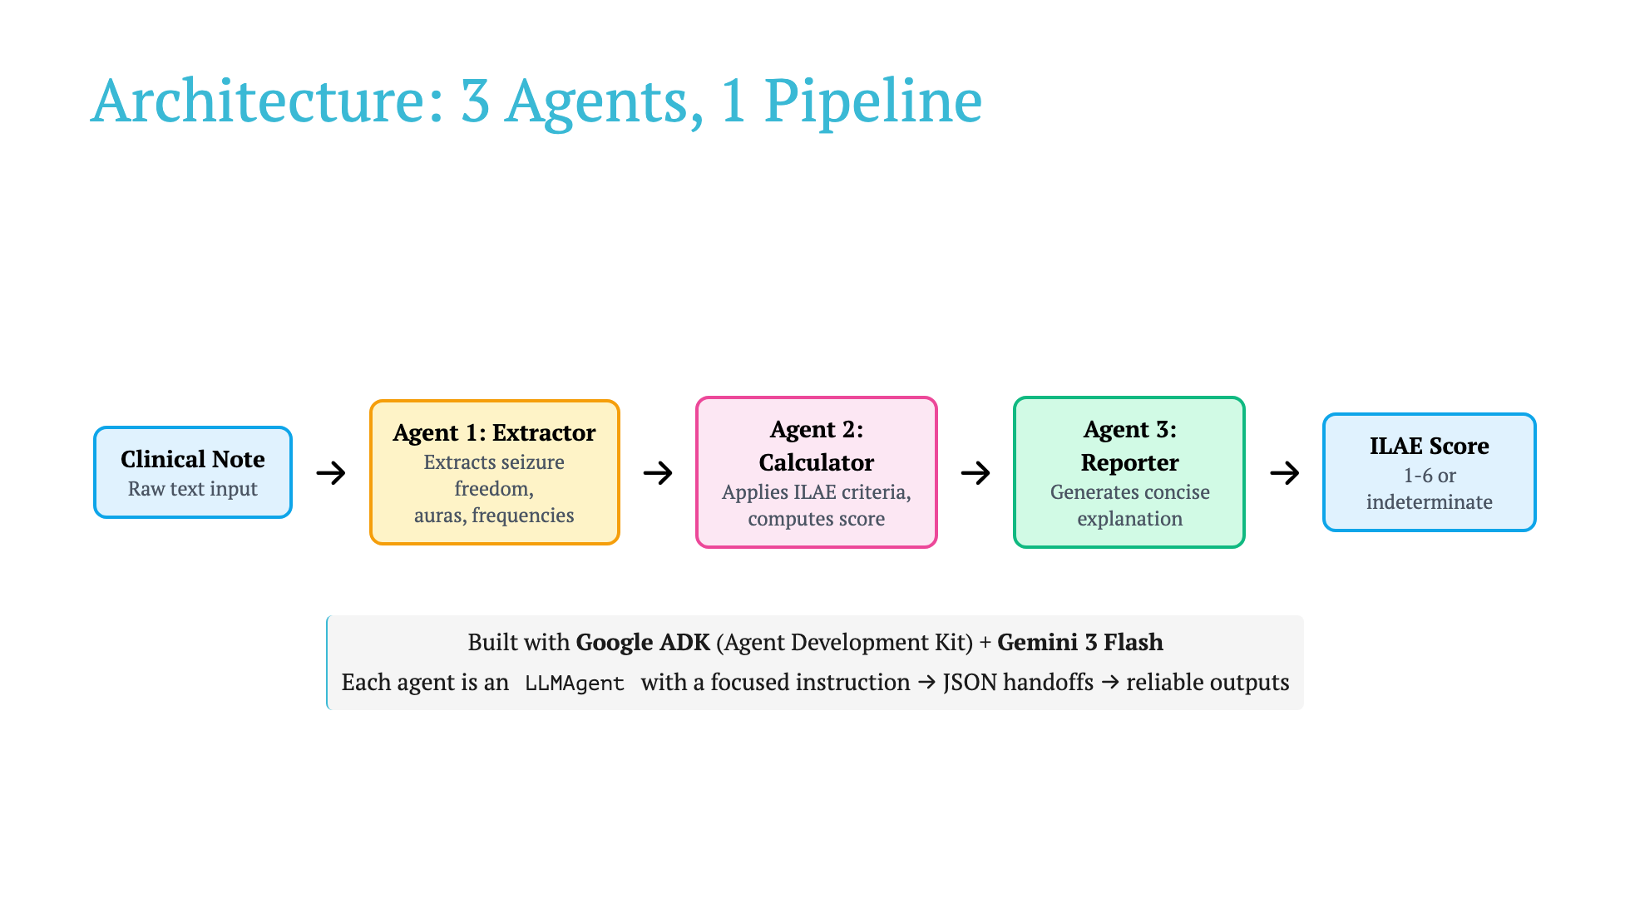
Notes:
Google's Agent Development Kit handles session management and agent orchestration.

Slide 13

Notes:
Replace YOUR_VIDEO_ID in the iframe src with your actual YouTube video ID

Slide 14

Notes:
Replace YOUR_VIDEO_ID in the iframe src with your actual YouTube video ID

Slide 15
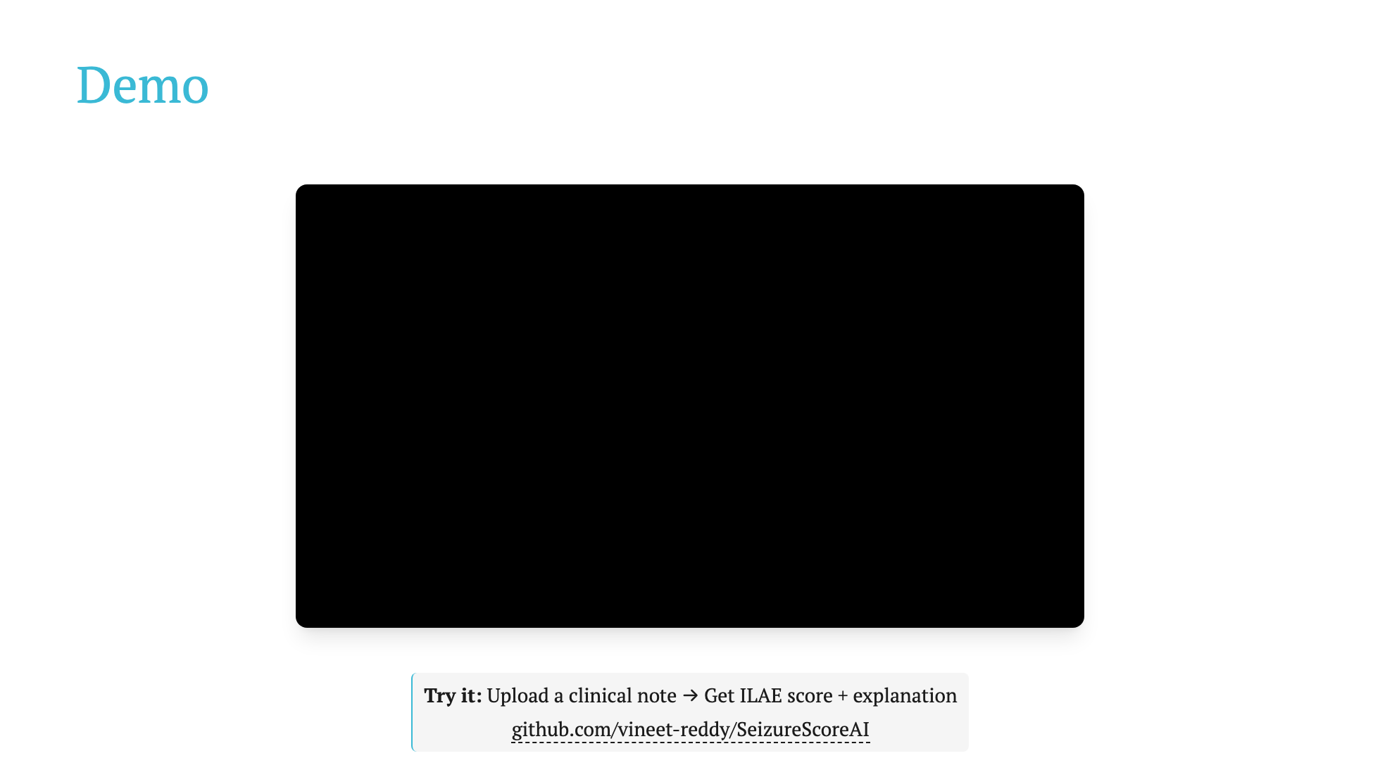
Notes:
Replace YOUR_VIDEO_ID in the iframe src with your actual YouTube video ID

